Slide 1
Marketing Analytics
Project 2 – Customer Segmentation

Slide 2
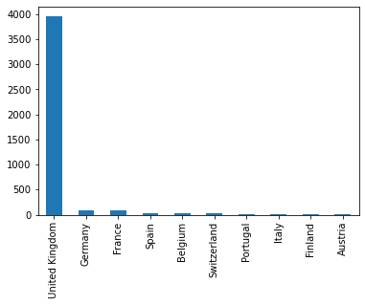
Overview of Problem / Requirement
Customer Segmentation allows the organization to deliver right product/services to the customer in a right way rather than targeting a larger audience of customers.
fig.1:Bar plot on country vs the number of customers
United Kingdom has the highest number of customers, and the lowest numbers of customers are in Australia.
So, we consider UK for the RFM Analysis.

Slide 3

Review of Data Source:Including description of data / Cleansing Required
Negative Quantity : Quantity is a Unit representation of the number of customers.
Invoice Date to calculate the Recency
Invoice No: for the Frequency
Total price for the Frequency

Slide 4
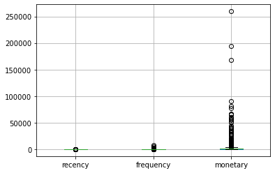
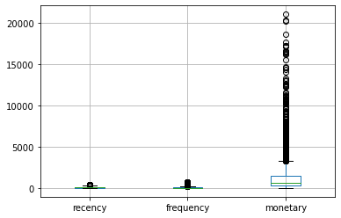
Distribution of data Outliers
Recency ,frequency and Monetary data have outliers.
Using Boxplot algorithm to remove the outliers .
Finding Z score to normalize the data

Slide 5
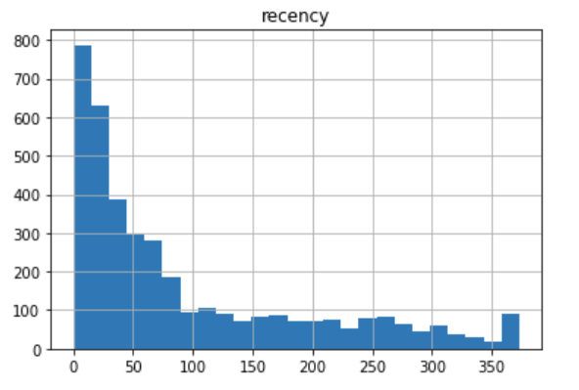
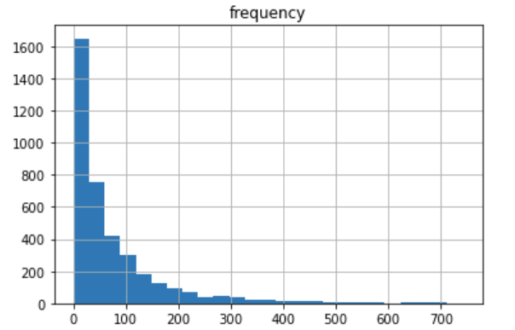
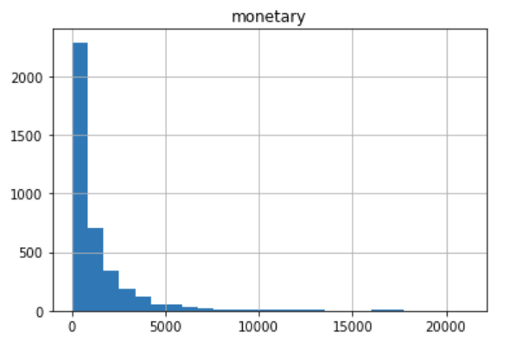
Descriptive Insights
From the Recency histogram we can see that the majority of customers have visited the store in the last 90 days
From the Frequency plot we can see that most of the customers have visited the store less than 50 times and the highest number of customers are one time visitors
A very small percentage of customers have spent more than $2500 at the shop.

Slide 6
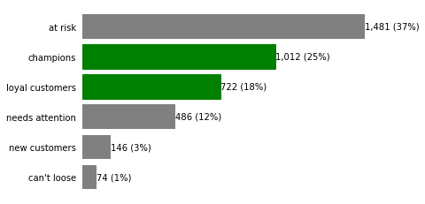
Descriptive Insights
Looking at the data available we can categorize our customers into the following categories,
1) Champions – Customers who buy frequently and recently
2) Loyal Customers – Customers who buy recently and frequently but not as much as champions (Potential Champion candidates)
3) New Customers – Customers who have recently purchased for the first time
4) Can’t Loose – Customers who buy frequently but have not been active recently
5) Need Attention – Customers who have not purchased recently but have frequented the store in the past
6) At Risk – Customers who have not been active for a prolonged period of time and also have not frequented the store in the past

Slide 7
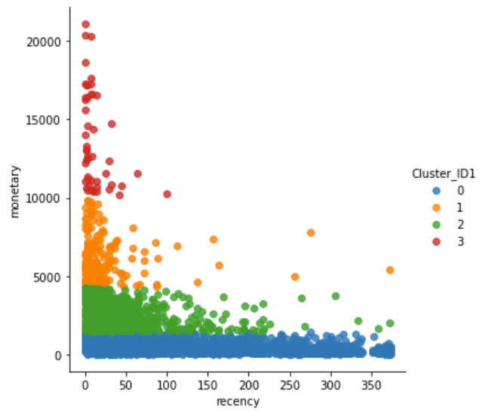
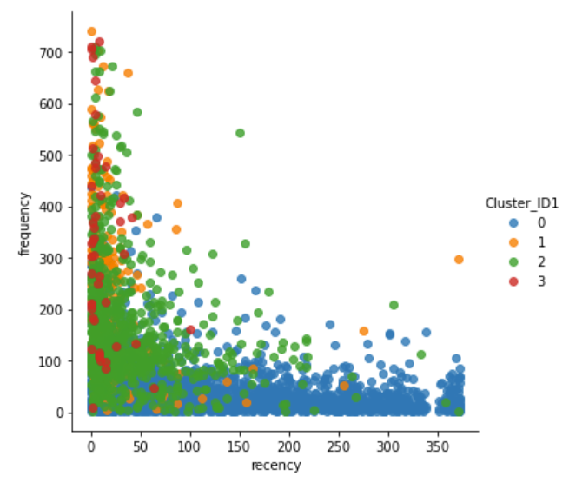
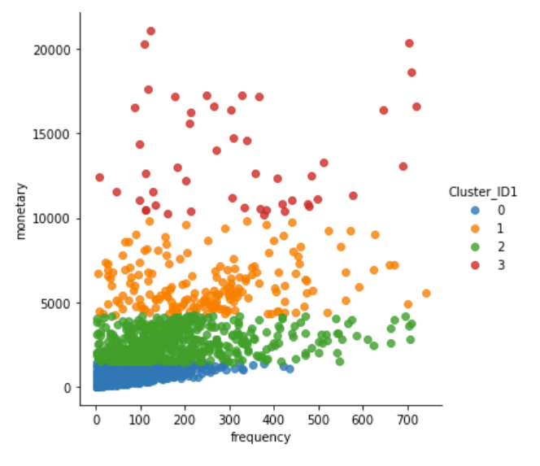
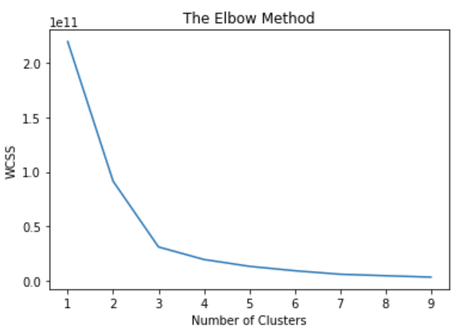
Results
We can see from the plots that, the segmentation has been done mostly based on the monitory gains from the customers.
Because of this we can see a clear segregation when monitory is in one if the axis but looks a little disoriented when it is not.
We can see here from the elbow method that 3 clusters is where the elbow is significant but we have chosen 4 to better understand the customer segments

Slide 8
Segmentation
Cluster | Monitory | Recency | Frequency
0 - Champions | Highest - $10,000 and Higher | Most customers have visited the store in the last 50 days | Ranges from one time visits to more than 700 independent visits
1 – Loyal Customers | Second Best - $5,000 to 10,000 | Most customers have visited the store in the last 100 days | Ranges from one time visits to more than 700 independent visits
2 – Need attention | Second least - $1,000 to $5,000 | Most customers have visited the store in the last 150 days | Most customers have a frequency less than 300
3 – At Risk | Least – Between $1 and $1000 | No definable limit for recency. | Most customers have a frequency less than 200

Slide 9
Future Recommendations
Champions – They are our best customers, use them to get feedback and provide offers. They will support the company in case of a new product or concept launch
Loyal Customers – The are second only to Champions, they can be nudged to become champions. Provide opportunities to visit the store more often and make them purchase more and become champions.
New Customers – Provide a pleasant experience, create a bond with the brand to ensure they stay with the company
Need Attention – They have been inactive for a while, provide offers they cannot say no to. Make them come back and shop with the brand.
Can’t Loose – They were once high value assets who are at risk of becoming inactive, provide special offers. Get feedback to understand needs and gaps in marketing or services provided
At Risk – They are the other who are at risk of leaving or hibernating, get feedback understand needs to start rebuilding the relationship

